Slide 1

 | S.S.V.P.S’s B. S. Deore Polytechnic, Dhule Academic Year : 2022 – 2023 Department of Computer Engineering (0059)
A seminar on Capstone Project Execution (CPE-22060)
Topic |  | Income and Expenditure Application for Farmer
Presented by |  | 1. Bidave Falguni Sanjay
 |  | 2. Desale Darshan Krushana
 |  | 3. Desale Lalit Dnyaneshwar
 |  | 4. Kolte Lakshmi Yogesh
Guided by |  | Mr. N.D. Patel
Semester |  | Sixth (I Scheme) | Date : 01/3/2024

Slide 2
Content
Abstract
Introduction (background of the industry or used based problem / task)
Literature Survey
Scope of the project
Methodology
Details of designs, working and processes
Results and applications
Conclusion and future scope
References and Bibliography

Slide 3
1. Abstract
The Proposed system “Income and Expenditure Application for Farmer“ will address the day to day challenges faced by farmers while maintaining his income and expenses incurred on household and Farming activities.
This system will help Farmers to keep track on their finances effectively and easily.
The proposed system will be developed using HTML, CSS, JavaScript, PHP and MySQL.

Slide 4
2. Introduction
Farmers are people engaged in farming activities.
Farming involves crop cultivation, growing crops, raising livestock and other agricultural allied activities.
These activities are performed to improve crop yield and aimed for better livelihood.
Crop yield depends on different climatic conditions.
In India, there are mainly three seasons like – kharif, rabbi and zaid
Crops are selected based on season. There are 3 crop seasons in India.
Crop Types in India | Period | Crops season | Crops grown
Kharif | June to October | Monsoon season | Rice, Corn, Bajra, Cotton, Soyabean, Turmeric.
Rabi | Mid-November to April or May | End of Monsoon season | Wheat, Peas, Jawar.
Zaid | Between March and June | Summer season | Watermelon, Tomato, Cucumber, Sugarcane.

Slide 5
2. Introduction
In India, though different crops suitable in varied climate and seasons are grown, farming practices, more or less, are same.
Farmer generates income and spend it (expenses) on various reasons for the purpose of his farm and family related activities.
Income means money that farmer receives from various income sources.
Expenses means money spend by the farmer.
In current climatic conditions, expenses may be more than income generated from farming.
So maintaining record of income and expenses in must for every farmer.

Slide 6
3. Literature Survey
3.1 Study of existing systems
We met the farmers in the village of “Deobhane”, which is located at 12 km from Dhule Taluka.
Crops grown in Deobhane
In kharif, they plant cotton, maize, bajara and onions.
In rabi, they plant gram, wheat, maize, onions, jowar and groundnut.
In addition, some farmers in the village still plant annual crops like bear fruit
Some farmers prefer to grow flowers, vegetables.
For each crop, such as land preparation, sowing, irrigation, weeding, pest control, fertilization, and harvesting.
The main source of irrigation is borewells and wells.
The farmer has different farms in various locations
Crops selection varies from farmer to farmer, location to location
Farmers track all of their expenses manually
They record income from selling crops.
Expenses are also recorded manually.

Slide 7
3.1 Study of existing systems
We met the Farmer named Shri. Krushna Budha Desale of Deobhane village.
While discussing we came to know :
A farmer can have multiple farms located at different locations.
Crops grown can vary from farm to farm, season to season
Crops selection is usually based on market demands.
These Farms incur various expenses and generate income.
Expenses are spend on various materials and methods of farming.
The expenses spend are on farming and household activities.
Income and expenses are recorded manually by a farmer.
We collected information about which crops are grown in different seasons and the climatic environment suitable for different crops.
We also collected information about the different farming activities conducted by a farmer and the respective methods and materials required for these activities along with their prices.
We studied about the overall expenses spend on different crops such as cotton, soyabean, wheat, maize, etc by a farmer.
Along with the expenses related to farming , we also studied the expenses spend for household purpose of a farmer such as groceries, education, medical, travelling, medical emergencies etc.

Slide 8
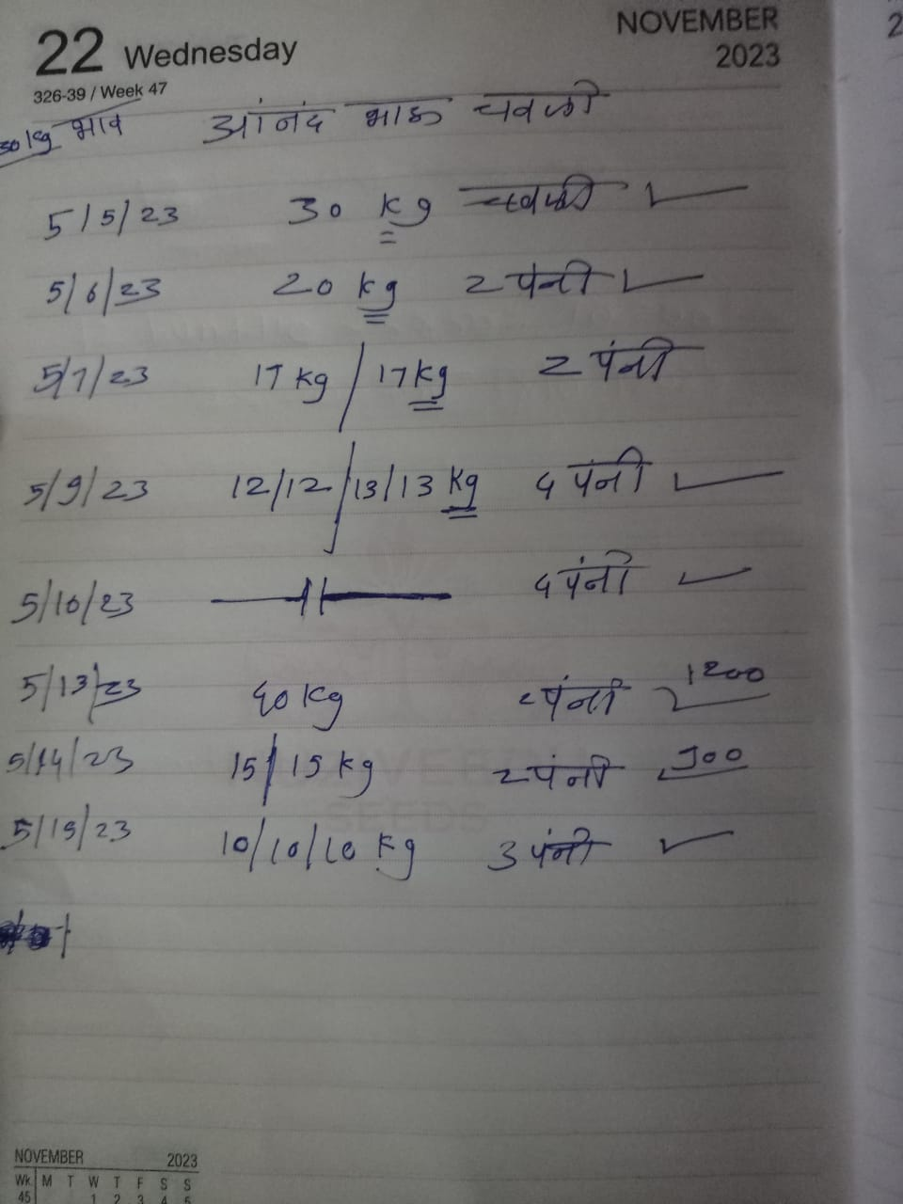
3.1 Study of existing systems
An example of record of income from crop maintained by the farmer-
Price of 1kg Black eyed gram
is 30 Rs
Income from Black eyed gram of 30 kg and date
Date of selling Black eyed gram with the respective quantity
Packs of Black eyed gram with kg

Slide 9
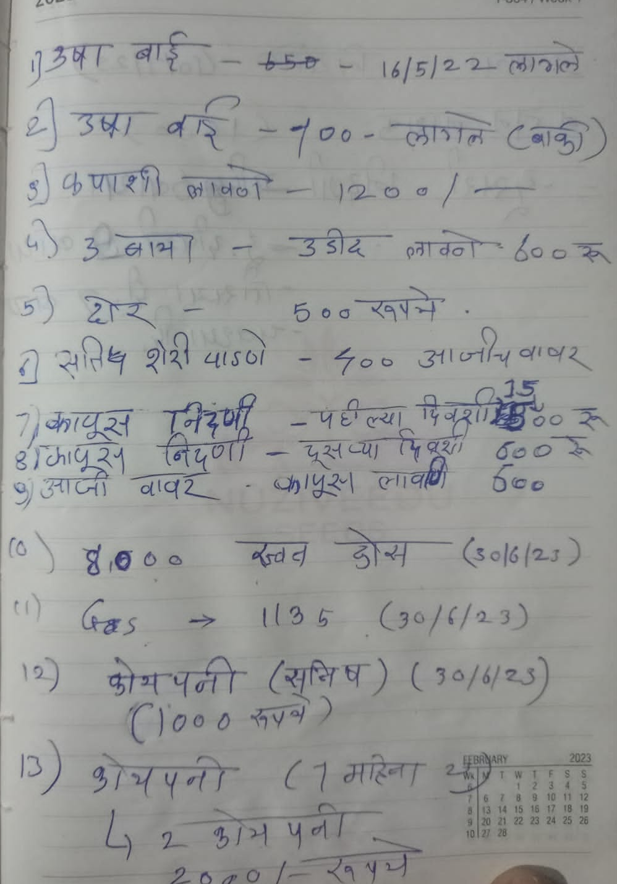
3.1 Study of existing systems
An example of record of expenses (farming and household) maintained by the farmer-
Labour named Usha
Bai was given 700 Rs
as advanced
1200 Rs required
For sowing Cotton
3 labours required
For sowing black gram
Land preparation for
different farms located
At different locations
Weeding of 2 days with amount
Fertilizer with required amount
The LPG Domestic gas required
For Household purpose
Weeding with respective amount

Slide 10
3.1 Study of existing systems
From the above discussion, income and expenses can be grouped based on farming activities
Income sources and expenses for farming are:
Sr. No. | Incomes from farming | Expenses on Farming activities
1. | Agricultural products | Labours, Tractors, Sprayers
2. | Livestock Sales | Plastic mulch, Manure
3. | Dairy Production | Drips, Pipes, Sprinklers
4. | Egg Production | Transportation of crops
5. | Renting Equipment | Crop Insurance
6. | Working as a Labour | Farm loan
7. | Renting Machineries | Electricity bill (Farm)
8. |  | Repair and maintenance

Slide 11
3.1 Study of existing systems
Expenses for Household are:
Groceries
Expenses on Household activities
Medical
Groceries
Education
Travelling and Transport
Life, Health Insurance
Personal Loan
Electricity bill (House), Fuel
Repair maintenance

Slide 12
3.1 Study of existing systems
The Farming expenses are incurred on various categories (methods).
Every method requires one or more material as mentioned below-
Common Materials :
Labours
Tractors
Sprayers
Specific Materials :
Rototiller
Manure & Compost
Plastic Mulch
Drips, pipes, sprinklers
Hooked curved
Fertilizers
Gloves
Harvesters
Seeds/saplings
Methods | Materials
Soil Preparation | Labours, Tractor, Rototiller, Manure,
Mulching | Labours, Sprayers, Plastic mulch
Sowing | Labours, Tractor, Seeds / Saplings
Irrigation | Labours, Drips, Pipes, Sprinklers
Weeding | Labours, Rototiller, Hook curved
Fertilizing | Labours, Sprayers, Fertilizer, Gloves
Harvesting | Labours, Tractor, Harvester

Slide 13
3.1 Study of existing systems
We also studied about an App which also records the income and expenditure of a farmer.
Farmer’s Wallet App
Mr. Kirwana Fred of Bivatec Ltd., Uganda developed this app.
Released it on 23rd December 2018.
This app :
Records farmer details.
Provides facility to enter incomes and expenses
This application helps farmers and create text reports that give information about their farm.
Farmers can track expenses, income, and other relevant data on this app.

Slide 14
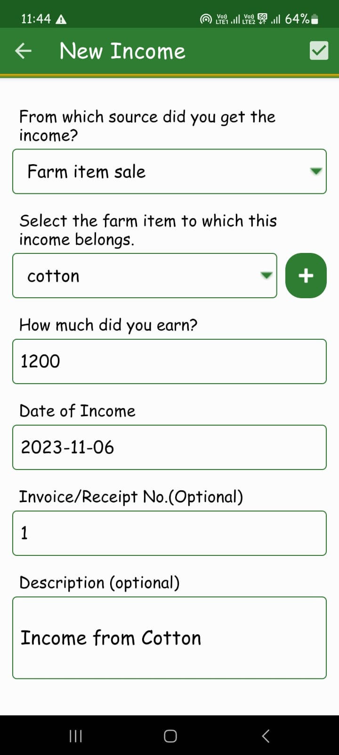
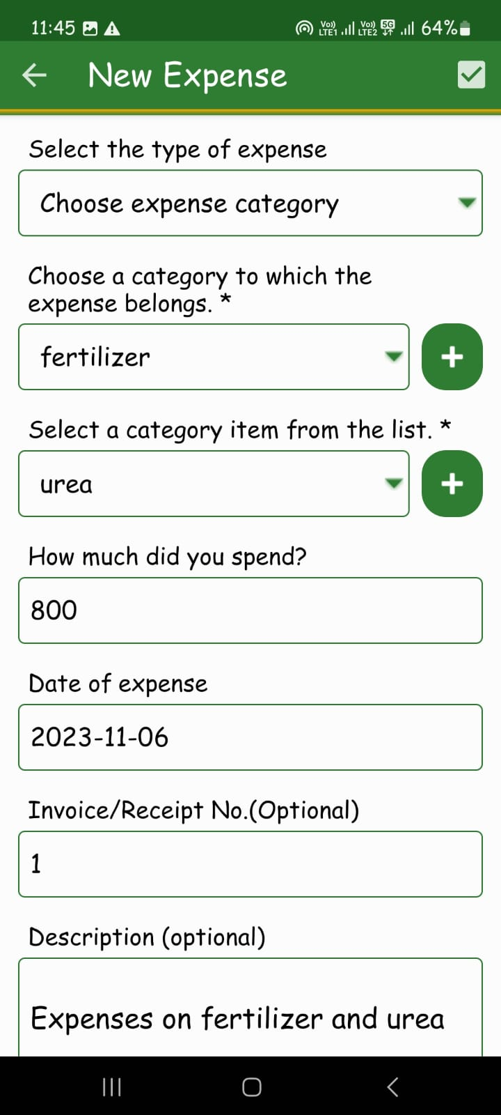
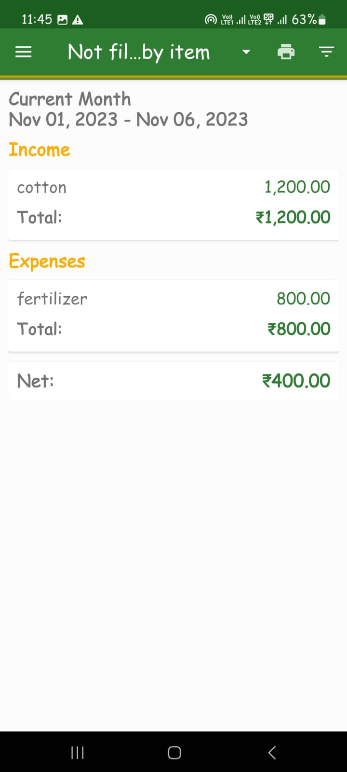
3.1 Study of existing systems
This page accepts the income of a
farmer along with income source & date
This page accepts the expense of a farmer along with the amount and date
This page displays the total income and expense of a
farmer

Slide 15
3.2 Limitations of existing system
Limitations of manual record keeping of income and expenses of a farmer:
Record Keeping :
Income and expenses on both – farming and household are clubbed together in a single record
Organizing and categorizing expenses and income can be more challenging when done manually, leading to confusion.
Difficult to maintain farm location wise income and expenses
Farmer Error: Farmers can make mistakes while recording income / expenses, in calculation which can lead to inaccurate financial records.
Incomplete Records: Missing or incomplete entries are very common. This leads to an inaccurate information of farming.
Time-Consuming : Keeping manual records is time-consuming.
Inefficiency: Searching for specific information or generating reports from manual records can be inefficient and time-consuming.
Data Security: Manual records can be lost, damaged, risking the loss of important financial information.
Lack of Analysis: Manual records may not support the detailed analysis of farm finances, which can help in making future decisions and improving profitability.

Slide 16
3.3 Problem Identification / Need of a system
Problems of farming related income and expenses :
Farmer is unable to find expenses according to particular month/year.
Farmer is unable to arrange income and expenses based on categories
Farmer cannot find expenses for particular methods like - Soil preparation, Sowing, Harvesting and materials like - Tractor, Labour etc.
Cannot find if the crop will be profitable or not by analyzing the previous record of a farmer and so wise decisions can’t be predicted.
Also can not find particular expenses spend on different farms located in different locations.
In spite of record keeping, farmer is not able to take informed decision based on historical data.
Problems of Household related expenses :
Farmer is unable to find expenses for particular expense category for particular month/year.
Tracking expenses becomes difficult which in turn leads to overspending.
These problems paralyses the farmer’s decision making

Slide 17
3.4 Problem Definition
To develop a web based application that will facilitate the record keeping for farmer
related with farming income and expenses
related with household income and expenses
To achieve this , proposed system will provide -
Detailed categorization of income and expenses
Generation of different income and expenses reports
Cash flow analysis.
This will guide farmer in taking wise decisions to improve livelihood by increasing profit.

Slide 18
4. Scope of Project
4.1 User Requirements
Farmer :
The system should accept the Farmer and farm details.
Farm Requirements
The system should accept the details of farmer.
The system should accept the farm details.
The system should record the information of various farms located at different locations.
Income Requirements for Farming and Household:
The system should accept the income of a farmer depending on various farms.
The system should record the income of a farmer related to farming and household activities.

Slide 19
4. Scope of Project
The system should categorise income based on the income sources.
The system should provide detailed reports of income of a farmer depending on various farms.
The system should generate a detailed report of income of a farmer according to the specified dates.
The system should generate reports of income related to farming and household and activities.
The system should generate reports of income related to farming and household and activities.
The system should categorise the income of farming and household related activities

Slide 20
4. Scope of Project
Expense Requirements for Farming and Household:
The system should categorise expenses, material wise and method wise.
The system should categorise the expenses of farming and household related activities.
The system should accept the expenses of a farmer depending on various farms.
The system should record the expenses of a farmer related to farming and household activities.
The system should provide detailed reports of expenses of a farmer depending on various farms.

Slide 21
4. Scope of Project
The system should help to improve profitability of various crops by analysing the previous record/historical data.
The system should help to analyse the previous record of a farmer this will guide farmer to take wise decisions.
The system should generate a detailed report of expense of a farmer according the specified dates.
The system should allow to manage the expenses.

Slide 22
4. Scope of Project
4.2 System Requirements
Operating System : Windows OS
Platform: Visual Studio Code
Languages : HTML / React, CSS, JavaScript, PHP
Database : MySQL
4.4 Hardware Requirements :
Processor: INTEL i3 Processor Core
Hard Disk: 500 GB (min)
RAM: 2 GB or higher

Slide 23
5. Proposed Methodology
5.1 Proposed Work
The proposed system will have modules like :
- Farmer Management
- Farm Management
- Income Management
- Expenses Management
- Report Generation
- Search
The proposed system will accept the Farmer and farm details.
The system will accept the income and expenses of a farmer depending on various farms.
The system will record the income and expenses of a farmer related to farming and household activities.
The system will categorise expenses, material wise and method wise.
The system will provide detailed reports of income and expenses of a farmer depending on various farms.
The system will help to improve profitability of various crops by analysing the previous record.
The system will help to analyse the previous record of a farmer this will guide farmer to take wise decisions.
The system will generate a detailed report of income and expenses of a farmer according the specified dates.
The system will categorise the expenses of household related activities.
The system will generate reports of income and expenses related to household activities.

Slide 24
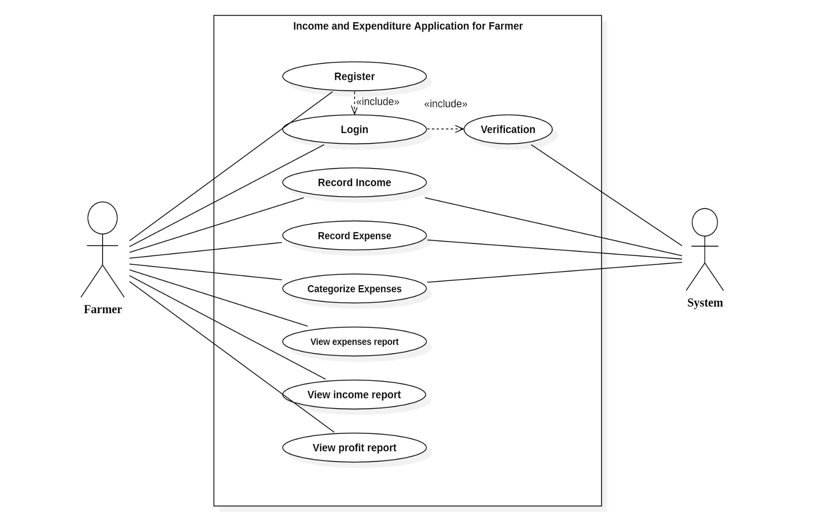
5.2.1 Use Case Diagram

Slide 25
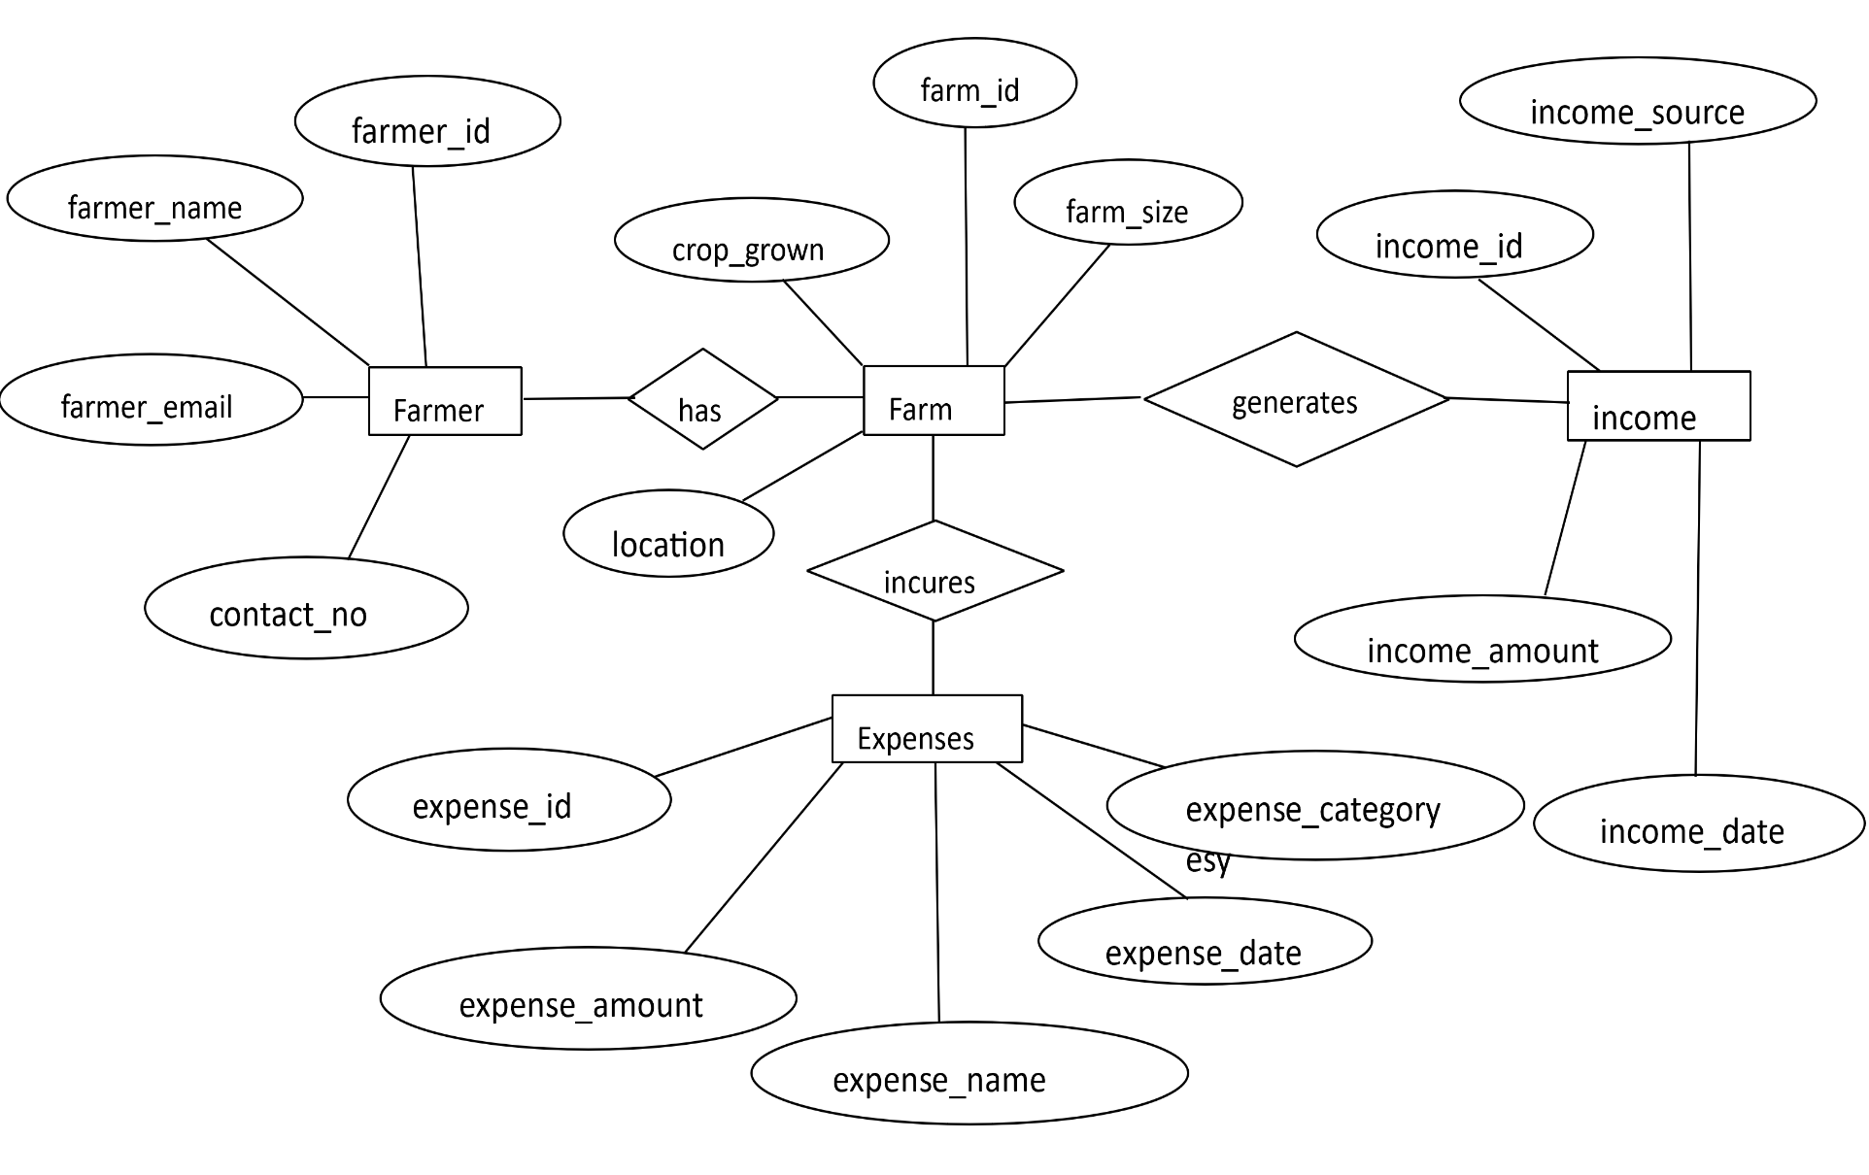
5.2.2 ER Diagram

Slide 26
5.2.3 Database Structure
Sr no. | Table name | Description | Fields
1. | Farmer_details | This Table will contain the Farmer details which will help to keep a record of farmer. | farmer_id farmer_name farmer_email
2. | Income | This Table will contain the Income details of a farmer which will help to keep income record of farmer. | income_id income_source income_amount income_date
3. | Expense | This Table will contain the Expense details of a farmer which will help to keep record of expenses made by farmer. | expense_id expense_category expense_amount expense_date
4. | Expense_category | This table helps to make categorization of expenses made by farmer. | category_id category_name
5. | Farm_details | This table will contain the farm details which will help to keep record of various farms of a farmer. | farm_id land_details crop_grown

Slide 27
6. Details of designs, working and processes
System Diagram
Income and Expenditure Application for Farmer
Farmer Management
Farm Management
Income management
Expense management
Report Generation
Search
Detailed Reports of Income and Expenses
Farmer details
Specific Income details
Farm details
Specific Expense details
Income details
Comparative statement of incomes and expenses
Expense details
Farmer Details
Farm Details
Income Details
Expense Details

Slide 28
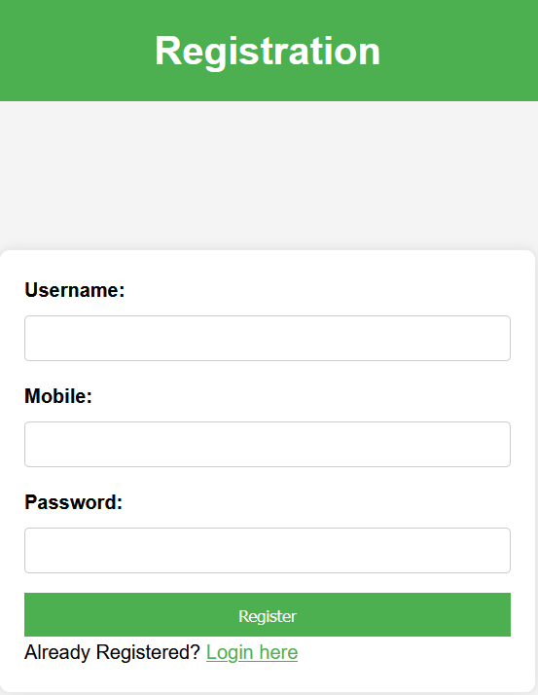
7. Results and applications
Farmer Management
Farmer Management module includes following details :
Username(Farmer Name)
Mobile No
This fields are necessary for identification of farmers
For identification of respective farms of the farmer

Slide 29
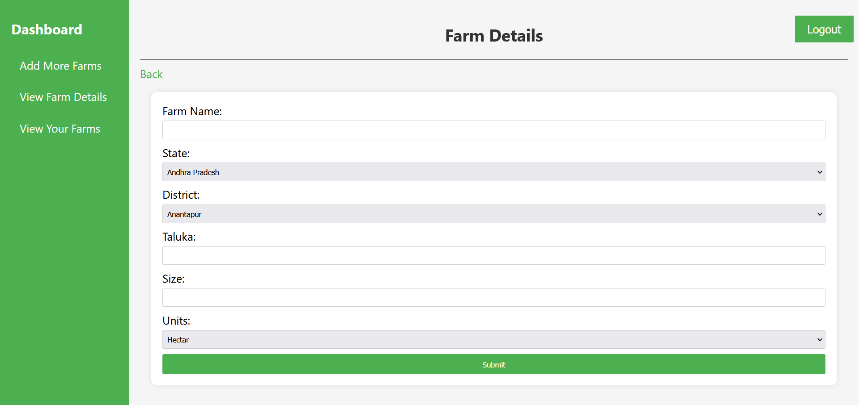
7. Results and applications
Farm Management
Add Farm functionality

Slide 30
7. Results and applications
When user logs into the system ,he would be prompted to enter the details about his farm i.e farm details would be accepted for every farm
The farmer(user) can add as many farms he possess
The details accepted are :
Farm Name(Name by which the farmer identifies his farms)
State, District, Taluka(Locations)
Size(Area of farm)
Units(for eg : bigha ,hectar ,acre ,etc)

Slide 31
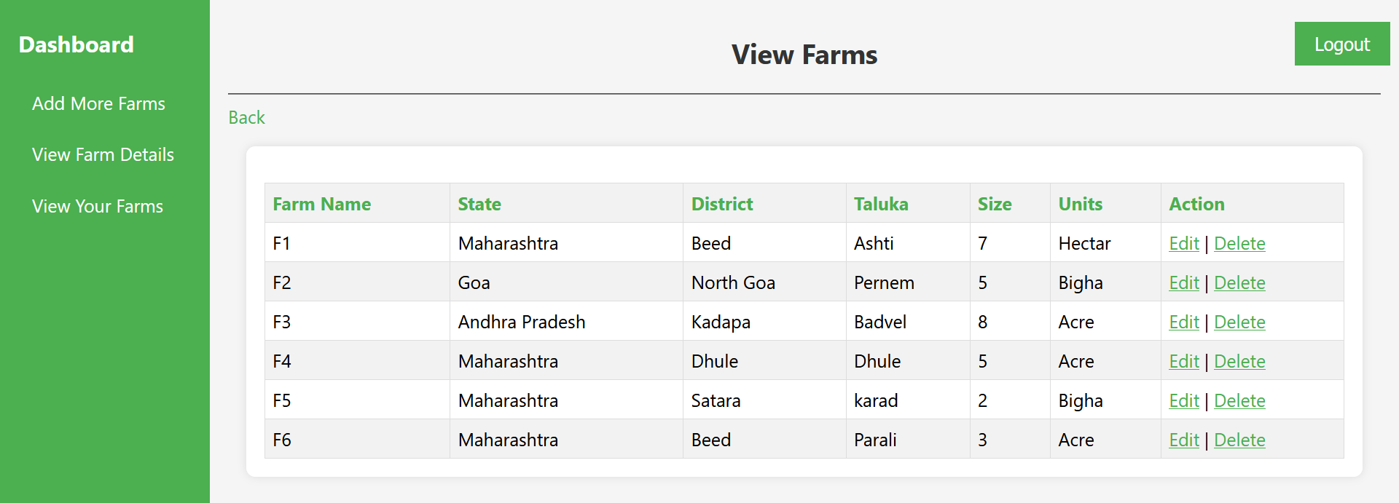
7. Results and applications
View Farm Details
After accepting the details , to make sure all details are correct he could view the details he entered. If required he could edit / even delete it .

Slide 32
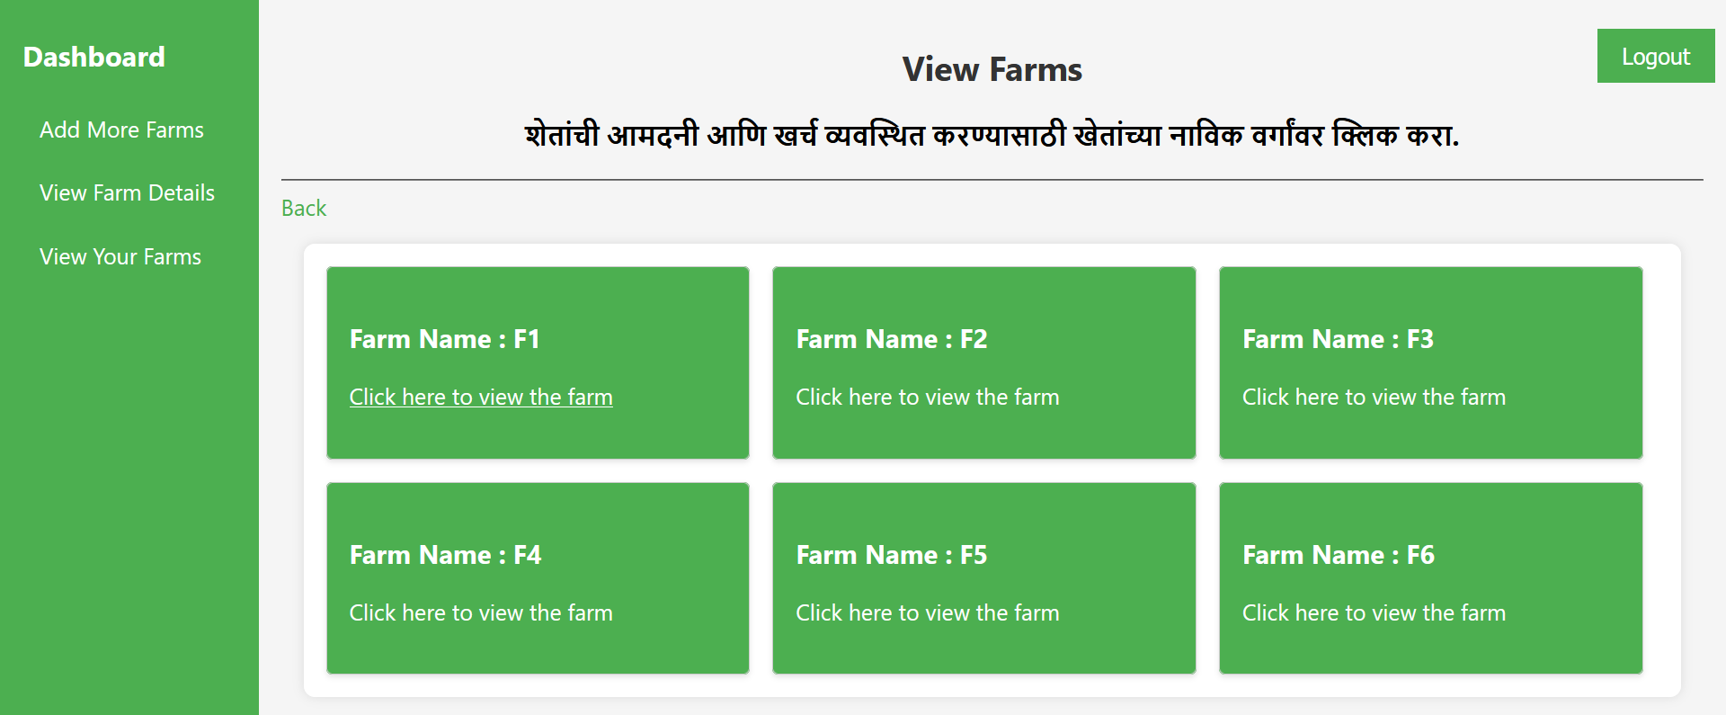
7. Results and applications
View your Farm
Also further he could view all his farms created .Where after clicking on respective farm let him to further process for that particular farm

Slide 33
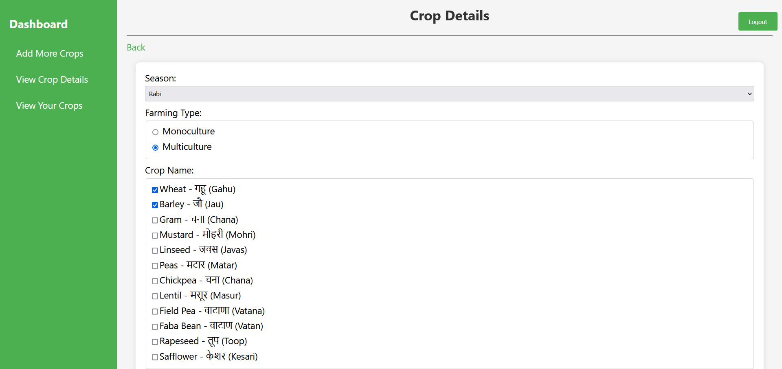
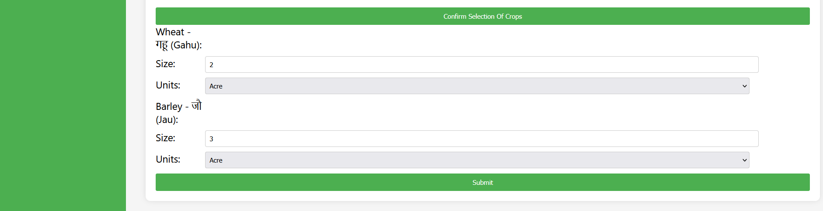
7. Results and applications
Crop Management : Add Crop Details

Slide 34
7. Results and applications
After accepting the details of farms ,Crop details would be accepted
The details accepted are :
Crop season(Seasons in India where crops are grown i.e Kharif, Rabi, Zaid)
Type of Farming(i.e Monoculture OR Multiculture)
This is needed to check whether the farmer is performing multiculture farming or Monoculture Farming
Since there might me many crops in one farm or one crop in one farm which means single or multiple crops respectively Based on the season is selected
Crop Name(Names of crops grown int the respective farms)
list of crops are displayed accordingly, for the farmer
In Monoculture ,single crop is selected whereas in Multiculture multiple crops are selected
Size and Units
For each crop it's size and the unit for computation is accepted

Slide 35
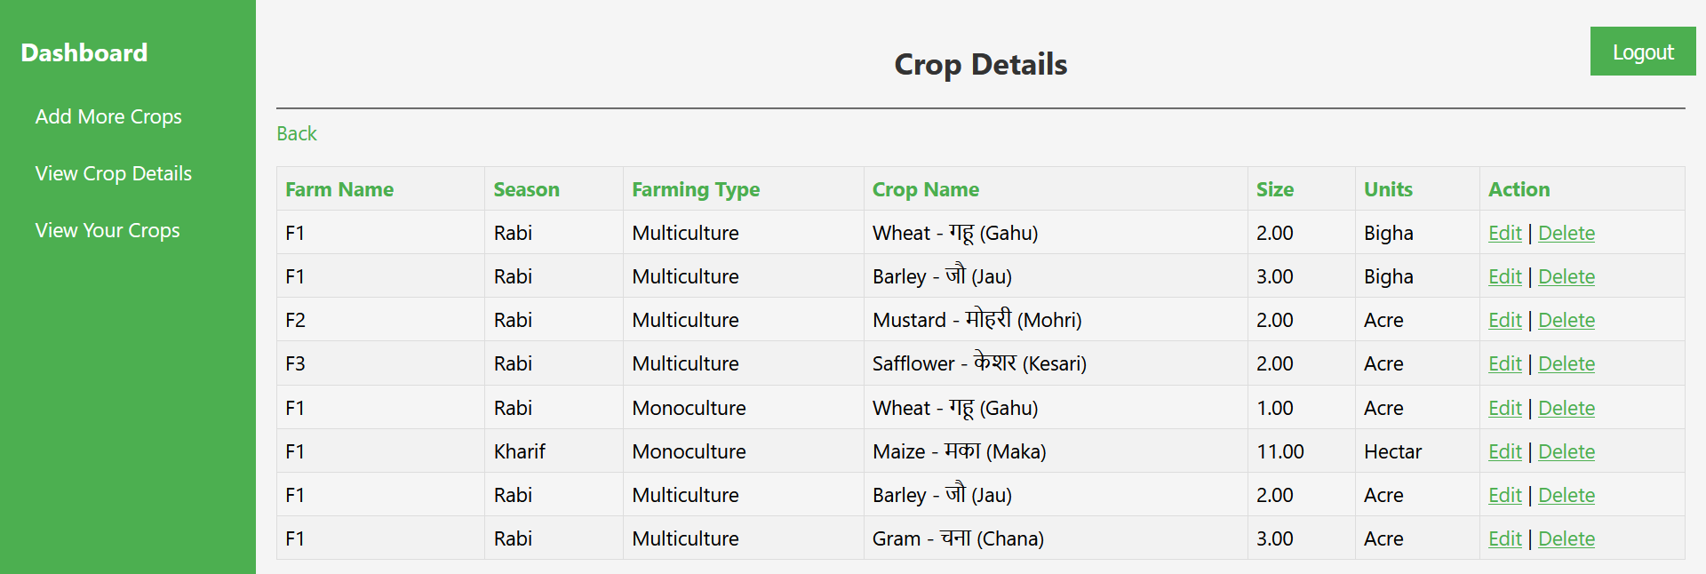
7. Results and applications
View Crop Details
The details of various crops along with the type of farming performed will be displayed .
The farmer can even edit or even the delete the crops

Slide 36
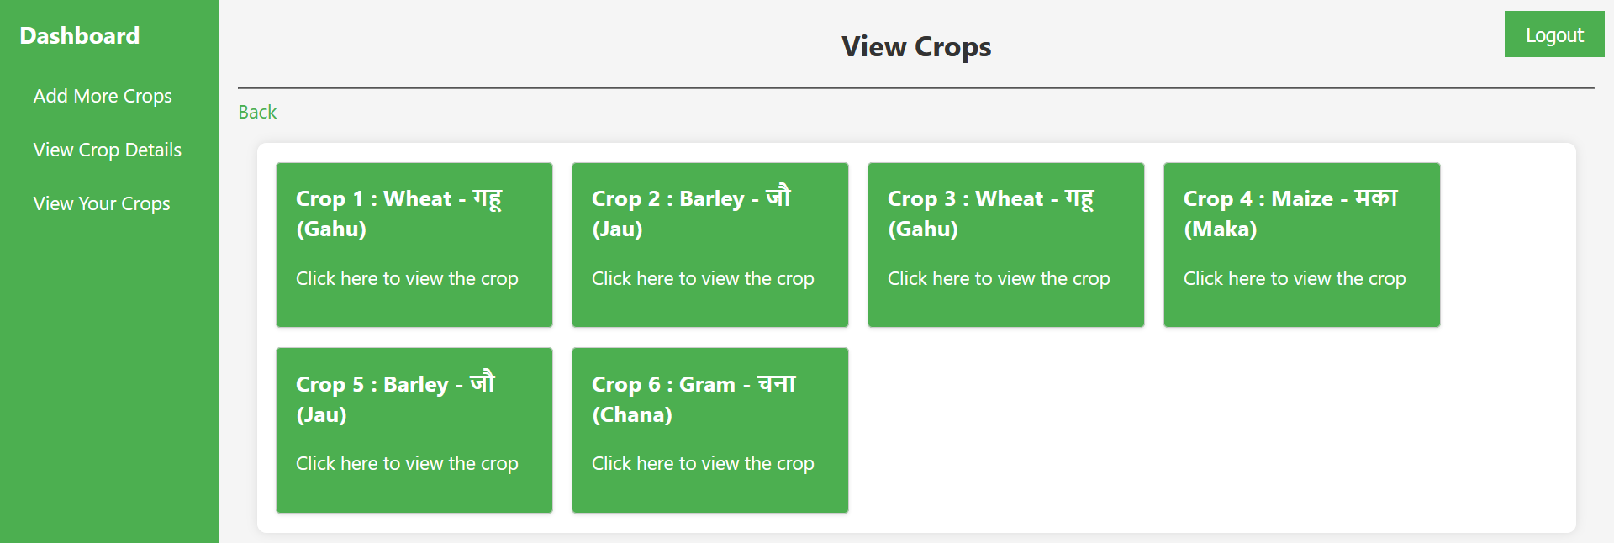
7. Results and applications
View your Crops
Also further he could view all his crops grown in respective farms
Where after clicking on respective crops let him to further process for Income and Expense Management

Slide 37
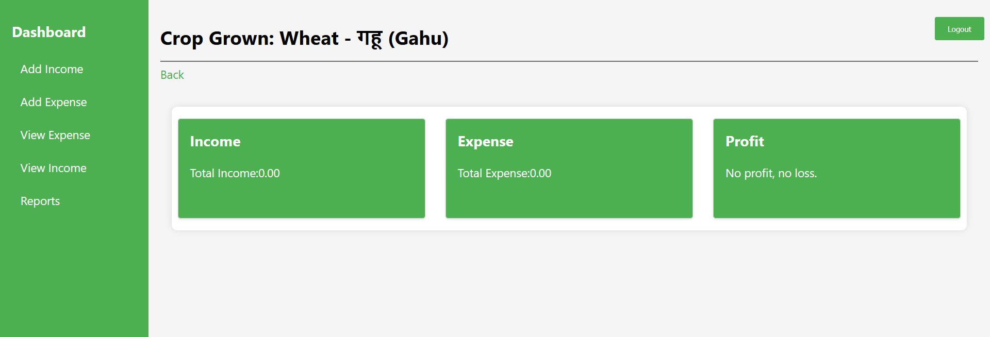
7. Results and applications
Dashboard of Income and Expense Management

Slide 38
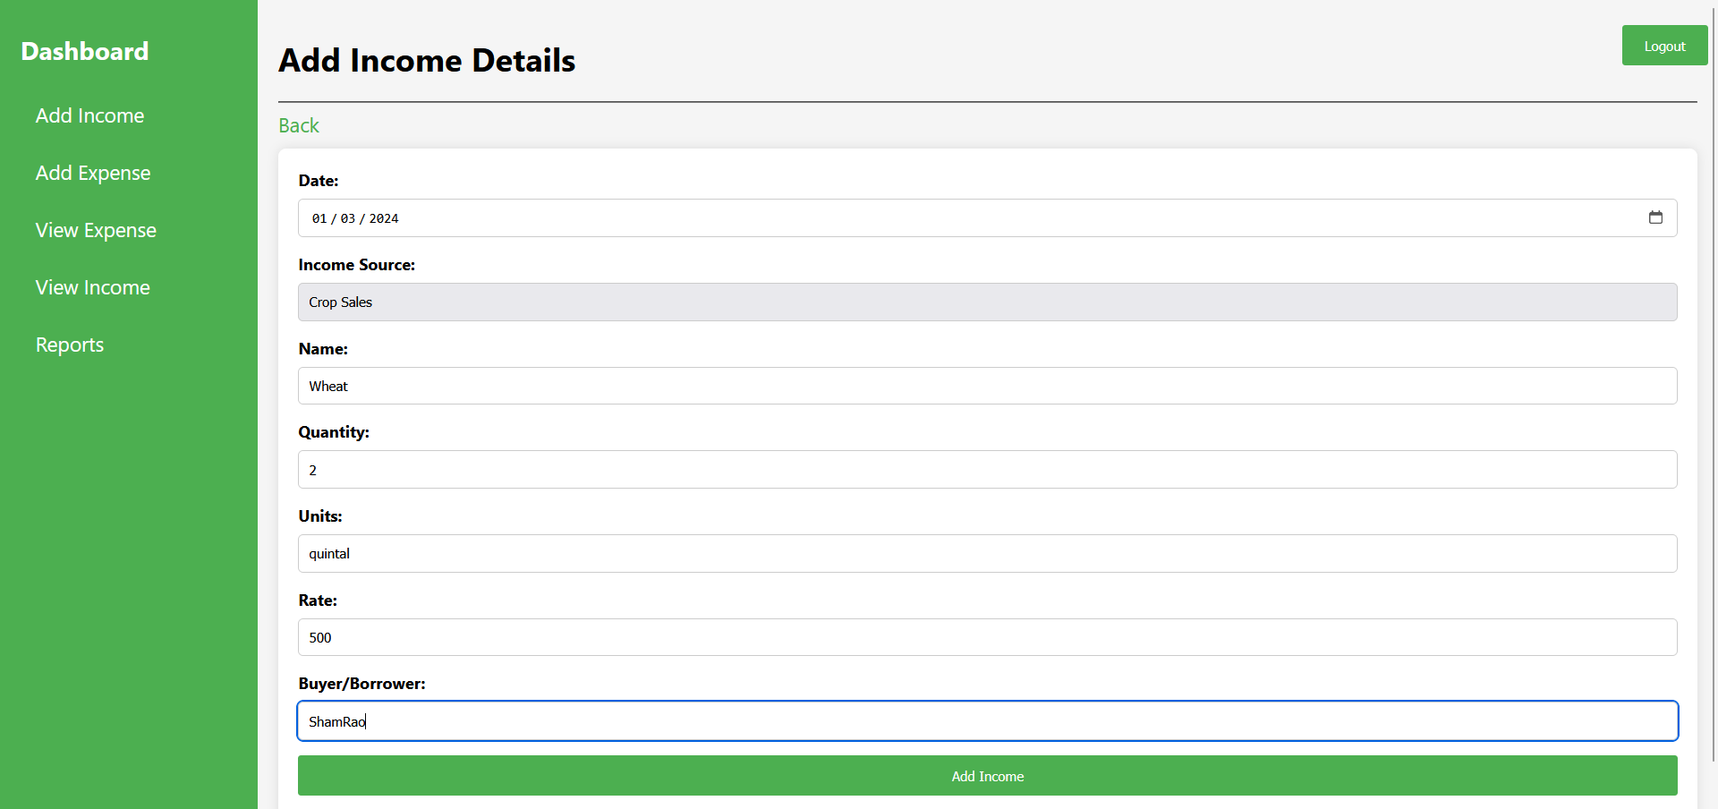
7. Results and applications
Income Management

Slide 39
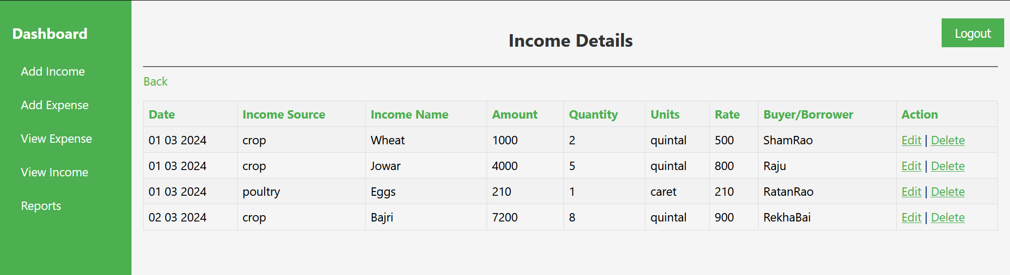
7. Results and applications
View Income Details

Slide 40
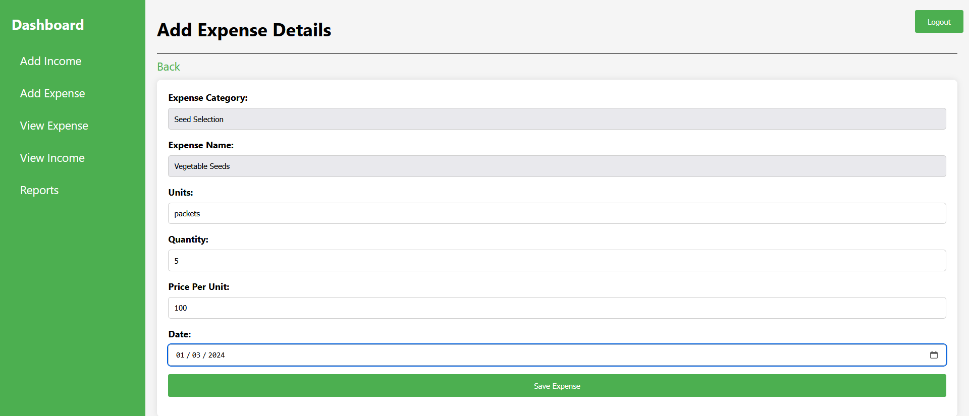
7. Results and applications
Expense Management

Slide 41
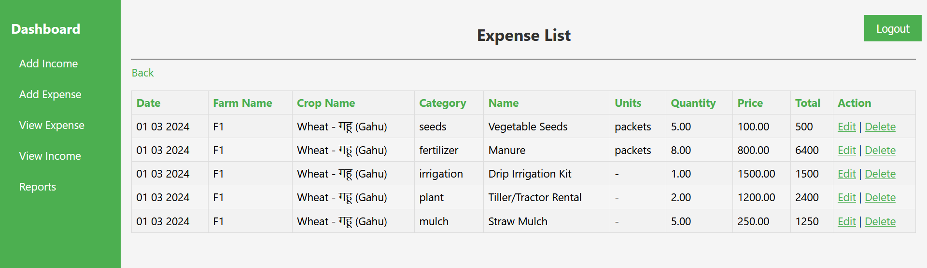
7. Results and applications
View Expense Details

Slide 42
7.2 Applications
This application is build for Farmers to efficiently manage their Income and Expenditure related to Farming as well as Household Activities

Slide 43
8. Conclusion and future scope
8.1 Conclusion
In conclusion, the Farmer Income and Expenditure Application provides a valuable tool for farmers to manage their finances effectively.
By tracking income sources and monitoring expenditures, farmers can make informed decisions to improve their financial health.
Overall, this application is a beneficial resource for farmers aiming to optimize their income and expenditure management

Slide 44
8. Conclusion and future scope
8.2 Future Scope
The Application can be made available for all over India
It can be made available in various languages as per various regions
It can even stored the data related to Advance Payments of labours

Slide 45
9. References and Bibliography
Farmer names with whom we discussed:
1. Krushna Budha Desale
2. Dnyaneshwar Vanji Desale
3. Jijabrao Shivaji Desale
Farmers Wallet Application
Mr. Kirwana Fred of Bivatec Ltd., Uganda developed this app.
Farmer Book

